Slide 1

Data Communication and Networks
DCN(ITPC-205)
Data Link Layer
Access Control

Slide 2
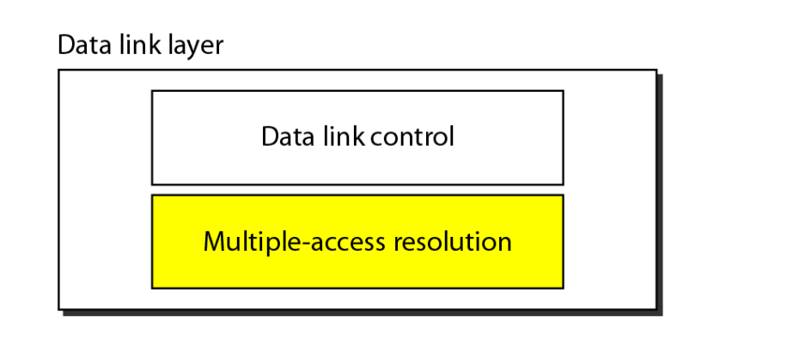
Data link layer divided into two functionality-oriented sublayers

Slide 3
The first section discusses random-access protocols. Four protocols, ALOHA, CSMA, CSMA/CD, and CSMA/CA, are described in this section. These protocols are mostly used in LANs and WANs.
The second section discusses controlled-access protocols. Three protocols, reservation, polling, and token-passing, are described in this section. Some of these protocol are used in LANs.
The third section discusses channelization protocols. Three protocols, FDMA, TDMA, and CDMA are described in this section. These protocols are used in cellular telephony.
Notes:
12.#

Slide 4


Multiple Access Control
Figure: Multiple-access protocols

Slide 5
Random access protocol
In random access or contention methods, no station is superior to another station and none is assigned the control over another.
No station permits, or does not permit, another station to send.
At each instance, a station that has data to send uses a procedure defined by the protocol to make a decision on whether or not to send.
If more than one station tries to send, there is an access conflict- called collision and the frames will be either destroyed or modified.

Slide 6
Random access protocol
To avoid access conflict or to resolve it when it happens, each station follows a procedure that answer the following question
When can the station access the medium?
What can the station do if the medium is busy?
How can the station determine the success or failure of the transmission?
What can the station do if there is an access conflict?
  ALOHA
  Carrier Sense Multiple Access
  Carrier Sense Multiple Access with Collision Detection
  Carrier Sense Multiple Access with Collision Avoidance

Slide 7

Pure ALOHA
Figure: Frames in a pure ALOHA network

Slide 8

Pure ALOHA protocol
Figure: Vulnerable time for pure ALOHA protocol

Slide 9

Pure ALOHA
Figure: Procedure for pure ALOHA protocol

Slide 10

Slotted ALOHA
Figure: Frames in a slotted ALOHA network

Slide 11

Slotted ALOHA
Figure: Vulnerable time for slotted ALOHA protocol

Slide 12
Throughput of pure and slotted ALOHA
The throughput for pure ALOHA is
S = G × e ^{−2G} .
The maximum throughput S_{max} = 0.184
when G= (1/2).
The throughput for slotted ALOHA is
S = G × e^{−G}.
The maximum throughput S_{max} = 0.368 when G = 1.

Slide 13
Example 1
The stations on a wireless ALOHA network are a maximum of 600 km apart. Find T_{p} & T_{B} for K = 2.
Assume that signals propagate at 3 × 10⁸ m/s
If we assume that signals propagate at
3 × 10⁸ m/s, we find T_{p} = (600 × 10³) / (3 × 10⁸) = 2 ms.
For K = 2, the range of R is {0, 1, 2, 3}. This means that T_{B} can be 0, 2, 4, or 6 ms, based on the outcome of the random variable R.

Slide 14
Example 2
A pure ALOHA network transmits 200-bit frames on a shared channel of 200 kbps. What is the requirement to make this frame collision-free?
Solution
Average frame transmission time T_{fr} is 200 bits/200 kbps or 1 ms. The vulnerable time is 2 × 1 ms = 2 ms. This means no station should send later than 1 ms before this station starts transmission and no station should start sending during the period (1 ms) that this station is sending.

Slide 15
Example 3
A pure ALOHA network transmits 200-bit frames on a shared channel of 200 kbps. What is the throughput if the system (all stations together) produces
a. 1000 frames per second?
b. 500 frames per second?
c. 250 frames per second?
Solution
The frame transmission time is 200/200 kbps or 1 ms.
a. If the system creates 1000 frames per second, or 1 frame
per millisecond, then G = 1.
In this case S = G × e^{−2G} = 0.135 (13.5 percent). This means that the throughput is 1000 × 0.135 = 135 frames. Only 135 frames out of 1000 will probably survive.

Slide 16
Example 3 (continued)
b. If the system creates 500 frames per second, or 1/2 frames
per millisecond, then G = 1/2. In this case S = G × e^{−2G}
= 0.184 (18.4 percent). This means that the throughput is
500 × 0.184 = 92 and that only 92 frames out of 500 will
probably survive. Note that this is the maximum
throughput case, percentage-wise.
c. If the system creates 250 frames per second, or 1/4
frames per millisecond, then G = 1/4. In this case S =
G × e^{−2G} = 0.152 (15.2 percent). This means that the
throughput is 250 × 0.152 = 38. Only 38 frames out of
250 will probably survive

Slide 17
Example 4
A slotted ALOHA network transmits 200-bit frames using a shared channel with a 200-kbps bandwidth. Find the throughput if the system (all stations together) produces
a. 1000 frames per second.
b. 500 frames per second.
c. 250 frames per second.
Solution
This situation is similar to the previous exercise except that the network is using slotted ALOHA instead of pure ALOHA. The frame transmission time is 200/200 kbps or 1 ms.

Slide 18
Example 4 (continued)
In this case G is 1. So S = G × e^{−G} = 0.368 (36.8
percent). This means that the throughput is 1000 × 0.0368 = 368 frames. Only 368 out of 1000 frames will probably survive. Note that this is the maximum throughput case, percentage-wise.
Here G is 1/2. In this case S = G × e^{−G} = 0.303 (30.3 percent). This means that the throughput is 500 × 0.0303 = 151. Only 151 frames out of 500 will probably survive.
Now G is 1/4. In this case S = G × e^{−G} = 0.195 (19.5 percent). This means that the throughput is 250 × 0.195 = 49. Only 49 frames out of 250 will probably survive.

Slide 19
Carrier Sense Multiple Access (CSMA)
To minimize the chance of collision and increase the performance, the CSMA method was developed.
The chance of collision can be reduced if a station senses the medium before trying to use it.
CSMA requires that each station first listen to the medium (or check the state of the medium) before sending.
In other words, CSMA is based on the principle “sense before transmit” or “listen before talk.”

Slide 20

Carrier Sense Multiple Access
Figure: Space/time model of the collision in CSMA

Slide 21

Carrier Sense Multiple Access
Figure: Vulnerable time in CSMA

Slide 22

Carrier Sense Multiple Access
Figure: Behavior of three persistence methods

Slide 23

Carrier Sense Multiple Access
Figure: Flow diagram for three persistence methods

Slide 24
Carrier Sense Multiple Access with Collision Detection (CSMA/CD)
The CSMA method does not specify the procedure following a collision. CSMA/CD gives the algorithm to handle the collision.
In this method, a station monitors the medium after it sends a frame to see if the transmission was successful. If so, the station is finished. If, however, there is a collision, the frame is sent again.

Slide 25

Carrier Sense Multiple Access with Collision Detection
Figure: Collision of the first bit in CSMA/CD

Slide 26

Carrier Sense Multiple Access with Collision Detection
Figure: Collision and abortion in CSMA/CD

Slide 27
Example 5
A network using CSMA/CD has a bandwidth of 10 Mbps. If the maximum propagation time (including the delays in the devices and ignoring the time needed to send a jamming signal) is 25.6 μs, what is the minimum size of the frame?
Solution
The minimum frame transmission time is T_{fr} = 2 × T_{p} = 512.2 μs. This means, in the worst case, a station needs to transmit for a period of 512.2 μs to detect the collision. The minimum size of the frame is 10 Mbps × 512.2 μs = 512 bits or 64 bytes.

Slide 28

Carrier Sense Multiple Access with Collision Detection
Figure: Flow diagram for the CSMA/CD

Slide 29
Carrier Sense Multiple Access with Collision Avoidance (CSMA/CA)
Carrier sense multiple access with collision avoidance (CSMA/CA) was invented for wireless networks.
We need to avoid the collisions on wireless networks because they can not be detected.
Collisions are avoided through the use of CSMA/CA’s three strategies:
  Inter frame space,
  Contention window, and
  Acknowledgments

Slide 30

Carrier Sense Multiple Access with Collision Avoidance
Figure: Flow diagram for CSMA/CA

Slide 31

Carrier Sense Multiple Access with Collision Avoidance
Figure: Timing in CSMA/CA

Slide 32
CONTROLLED ACCESS
In controlled access, the stations consult one another to find which station has the right to send.
A station cannot send unless it has been authorized by other stations.
We discuss three popular controlled-access methods.
  Reservation
  Polling
  Token Passing

Slide 33

Reservation
Fix the time for reservation
Data transmission period after reservation
Figure: Reservation access method

Slide 34
Polling
Polling works with topologies in which one device is designated as a primary station and other devices are secondary stations.
All the data exchange must be made through the primary device even when the ultimate destination is a secondary device.
Primary device controls the link; secondary devices follows its instructions.
It is up to the primary device to determine which device is allowed to use the channel at a given time.
If primary device want to receive the data, it ask from secondaries if they have anything to send, this is called poll function.

Slide 35

Polling
Figure: Select and poll functions in polling access method

Slide 36

Token Passing
Figure: Logical ring and physical topology in token-passing access method

Slide 37
CHANNELIZATION
It is a multiple-access method in which the available bandwidth of a link is shared in time, frequency, or through code, between different stations.
In this section, we discuss three channelization protocols.
  Frequency-Division Multiple Access (FDMA)
  Time-Division Multiple Access (TDMA)
  Code-Division Multiple Access (CDMA)

Slide 38

Frequency-Division Multiple Access (FDMA)
In FDMA, the available bandwidth of the common channel is divided into bands that are separated by guard bands.
Figure: Frequency-division multiple access (FDMA)

Slide 39

Time-Division Multiple Access (TDMA)
In TDMA, the bandwidth is just one channel that is timeshared between different stations.
Figure: Time-division multiple access (TDMA)

Slide 40

Note
In CDMA, one channel carries all transmissions simultaneously.

Slide 41

Figure 12.23 Simple idea of communication with code

Slide 42
The assigned code have two properties:
If we multiply each code with another, we get 0
If we multiply each code by itself, we get 4 (no. of stations)
12.<number>

Slide 43
Figure 12.24 Chip sequences

Slide 44
Figure 12.25 Data representation in CDMA

Slide 45

Figure 12.26 Sharing channel in CDMA

Slide 46
Suppose station 3 is listening to station 2.
Station 3 multiply the total data on the channel by the code of station 2.
[-1, -1, -3, +1] [+1, -1, +1, -1]= -4/4=-1 means bit 0
12.<number>

Slide 47

Figure 12.27 Digital signal created by four stations in CDMA

Slide 48

Figure 12.28 Decoding of the composite signal for one in CDMA

